Slide 1
Lifestyle
By Hui Zhou, Nicole Morris, & Qi Liu

Slide 2
Design Lead
Nicole Morris

Slide 3
0878A4
EDD170
Our App
C05640
003D73
Demo
000000
6BD178
1ECFD6

Slide 4
Layouts
3 Activities & 16 fragments

Slide 5
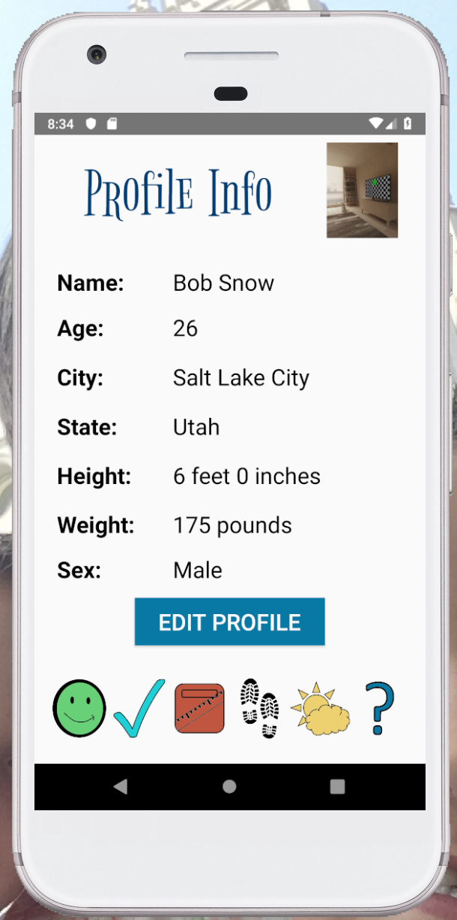
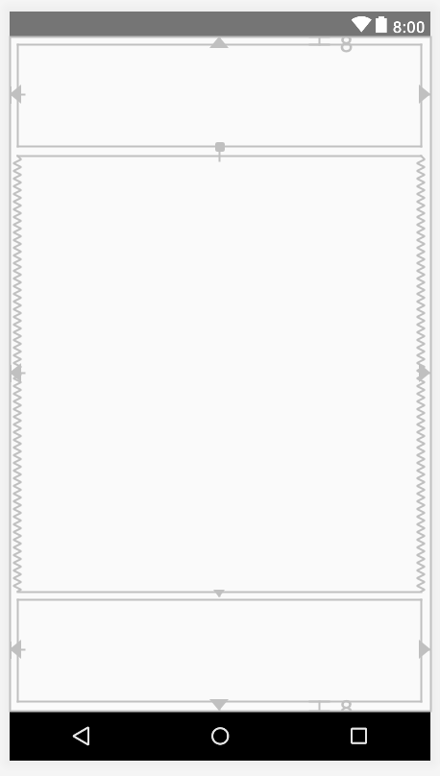
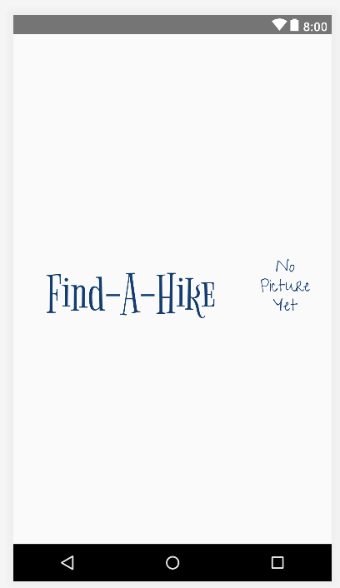
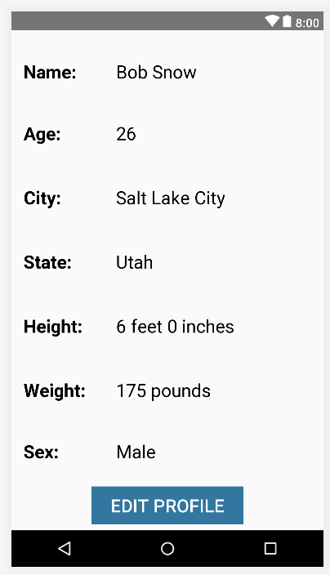
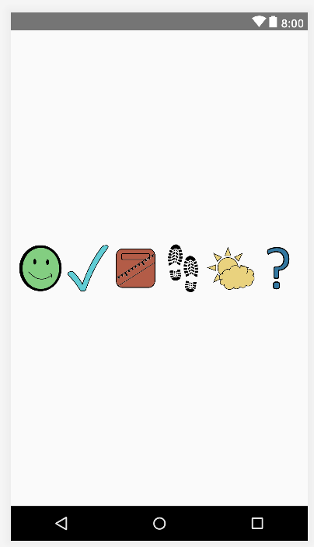
Most Views
Constraint Layout
Constraint Layout
Linear Layout

Slide 6
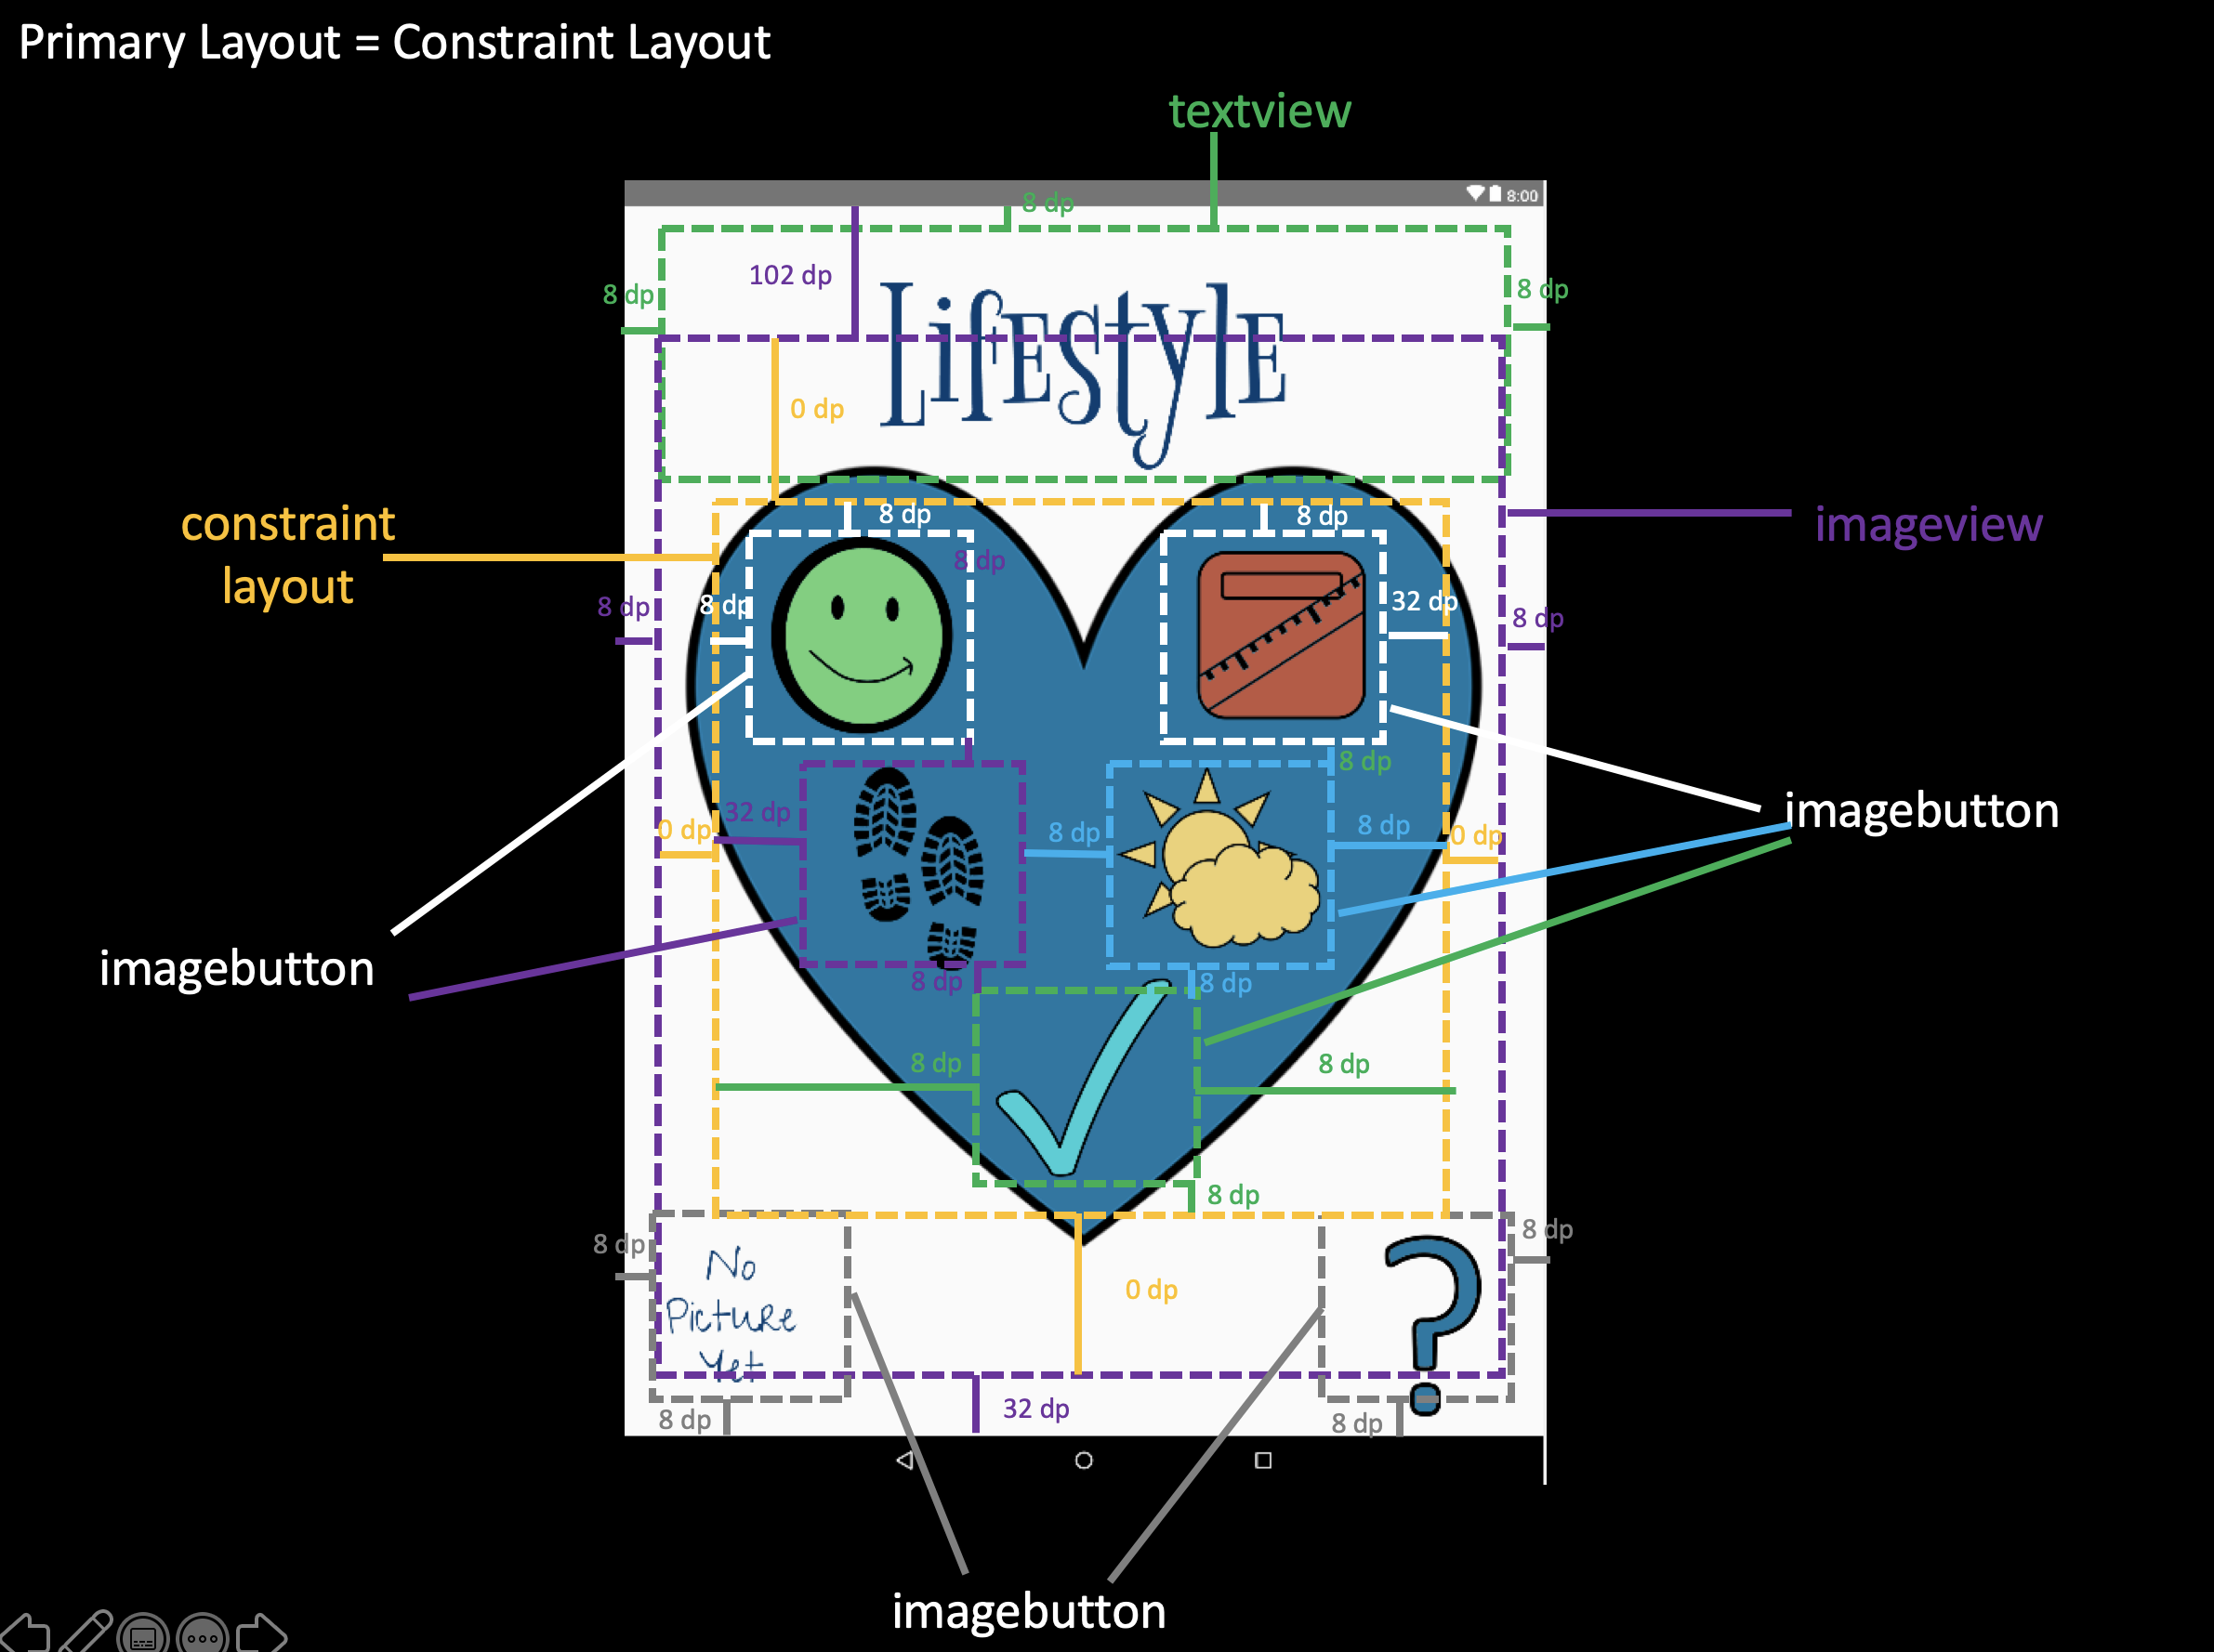
Choices Designed Fragment

Slide 7
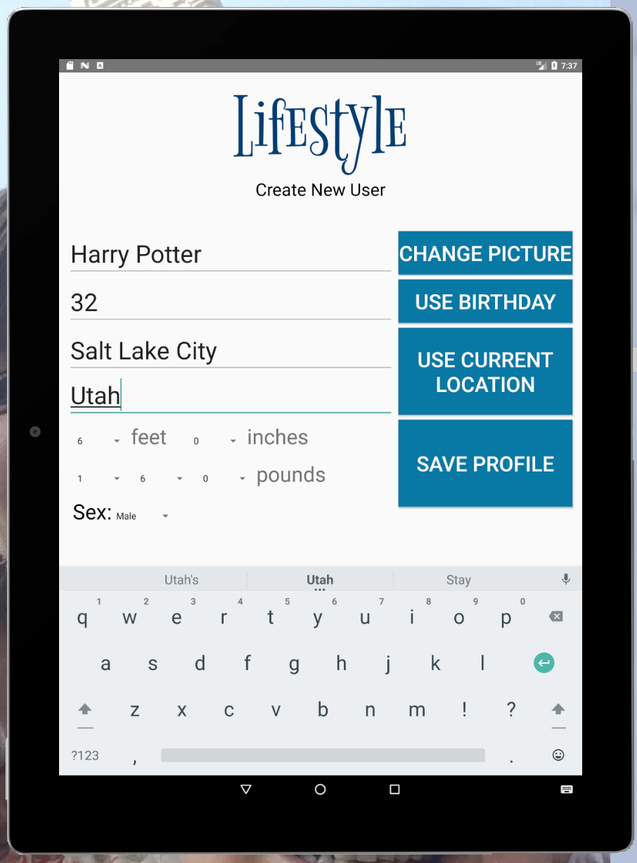
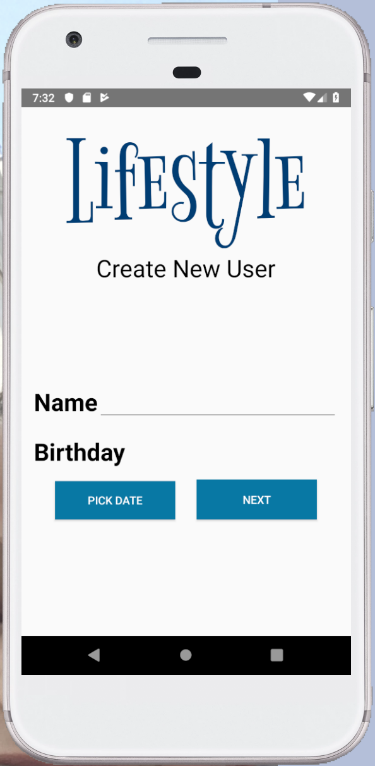
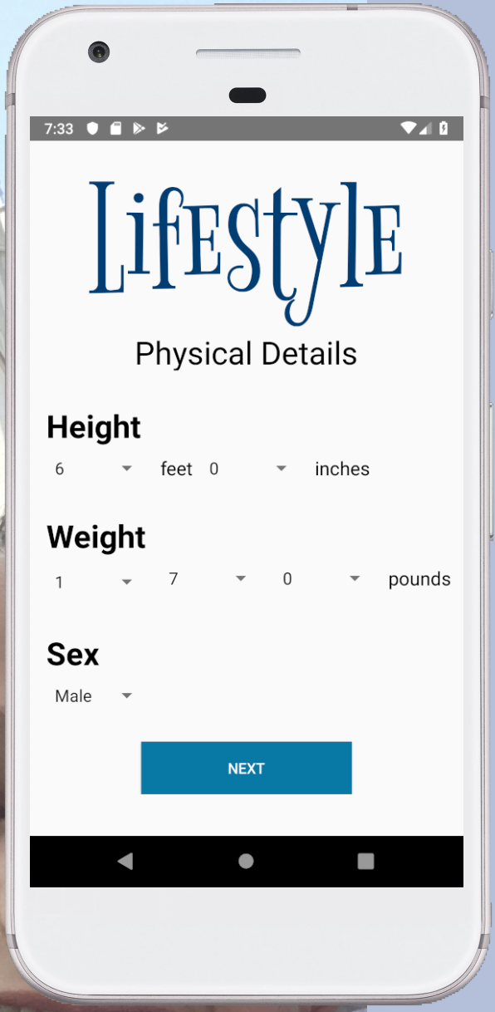
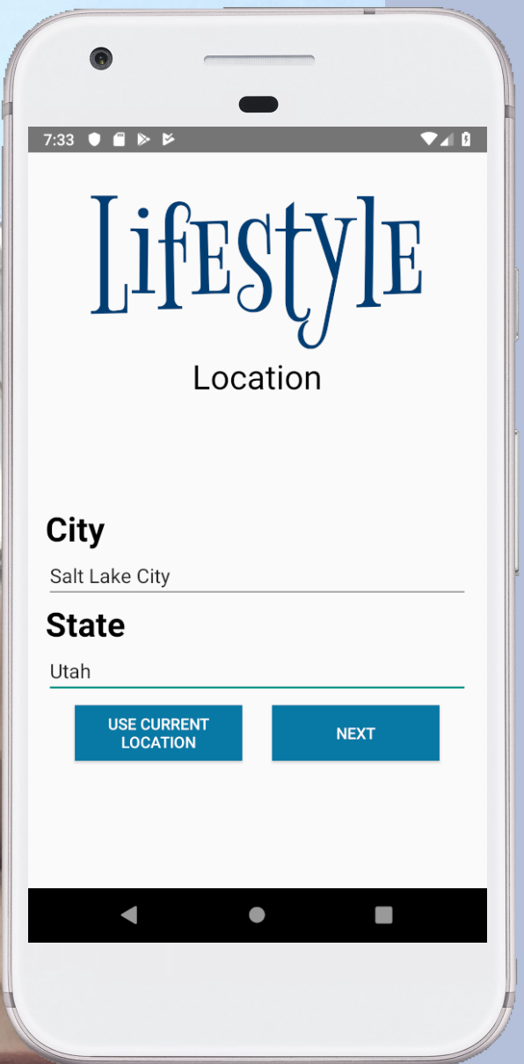
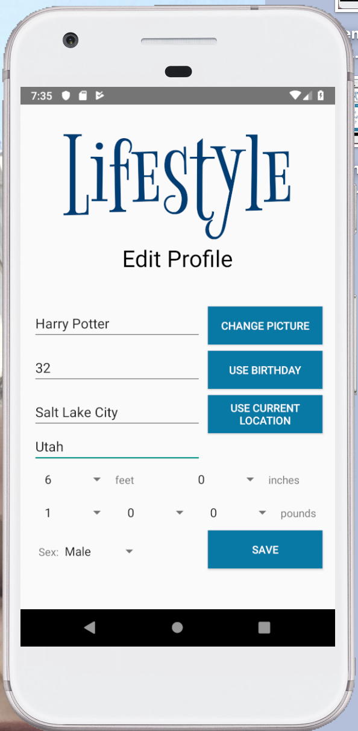
Phone vs Tablet
New User

Slide 8
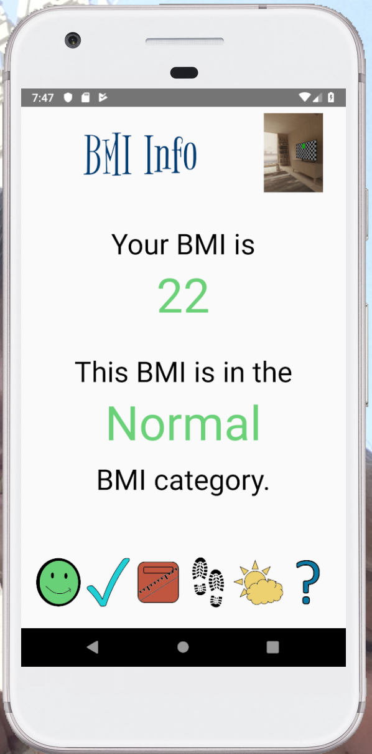
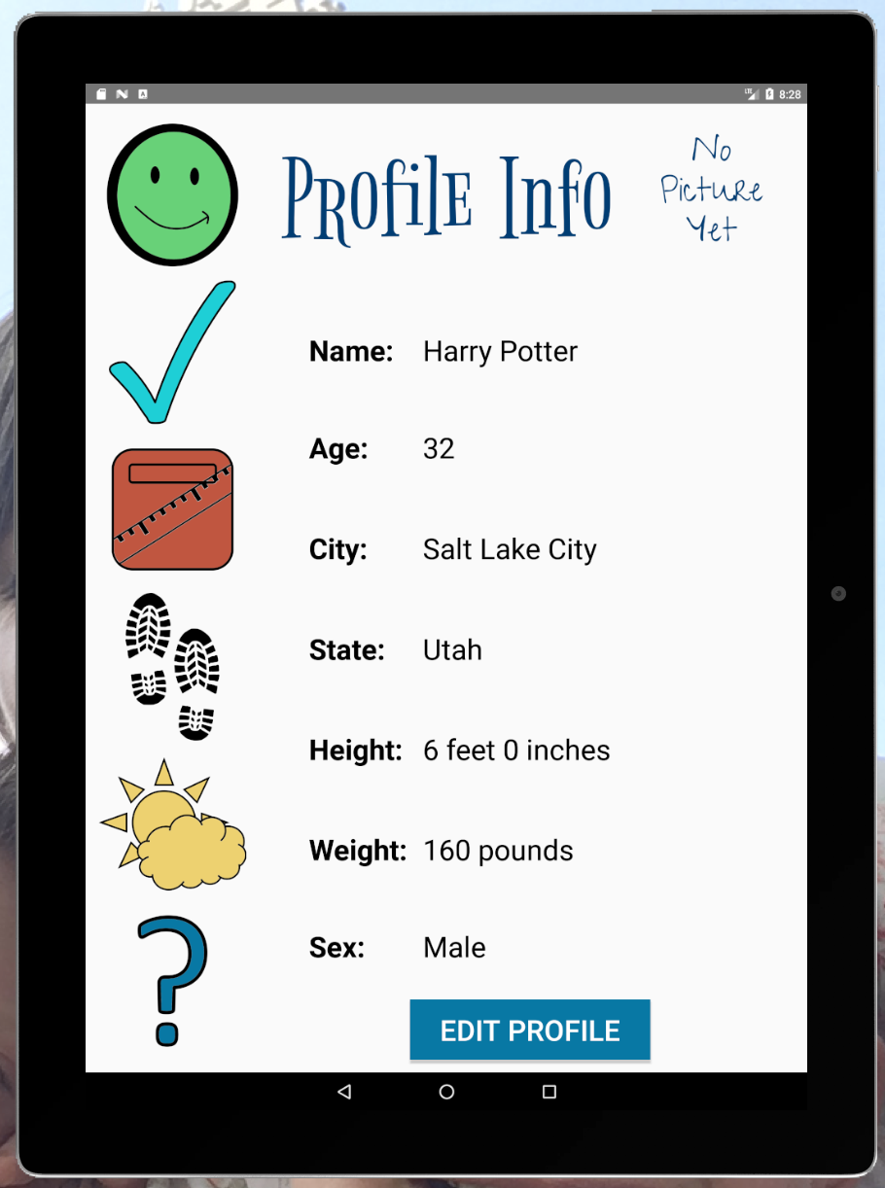
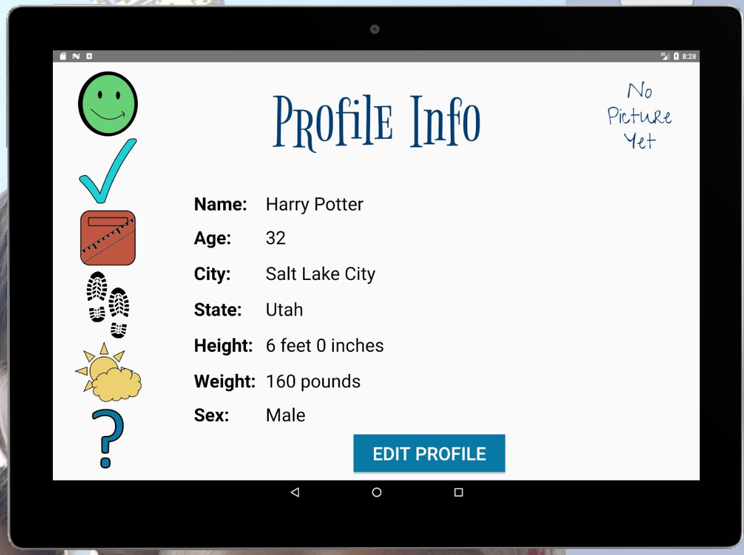
Phone vs Tablet
Menu Bar

Slide 9
Team Lead
Qi Liu

Slide 10
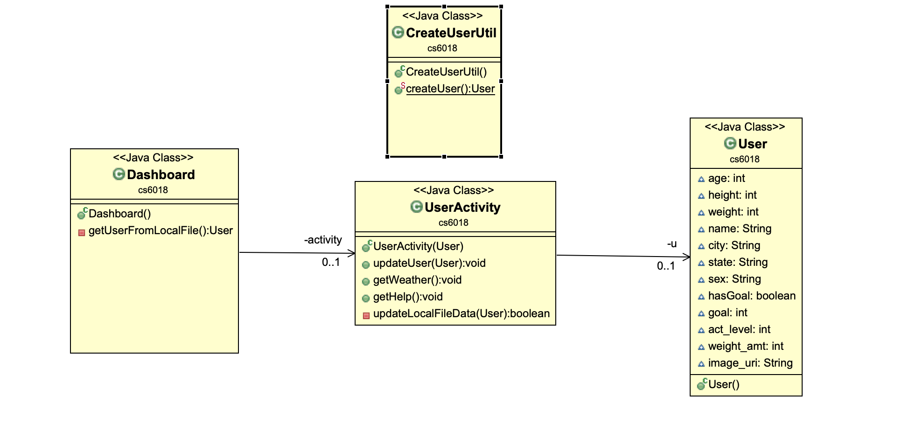
Current Class Diagram Design

Slide 11
Profile Info
int age;
int height;
int weight;
String name;
String city;
String state;
String sex;
String image_uri;
User Class

Slide 12
Goal Info
User Class
boolean hasGoal;
int goal;
int act_level;
int weight_amt;

Slide 13
BMI Info
User Class
int amount
int category

Slide 14
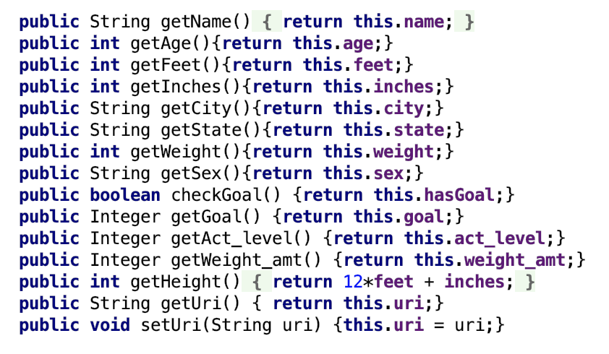
User Class
get and set methods

Slide 15
CreateUser Util Method
public static User createUser() {
User u = new User();
//Get set value from user input
u.setUserNameAndAge( String name, int age);
u.setPhysicalDetails();
u.setLocation();
u.setProfilePicture();
u.modifyUserData();
u.saveUserDataAtLocalFile();
}

Slide 16
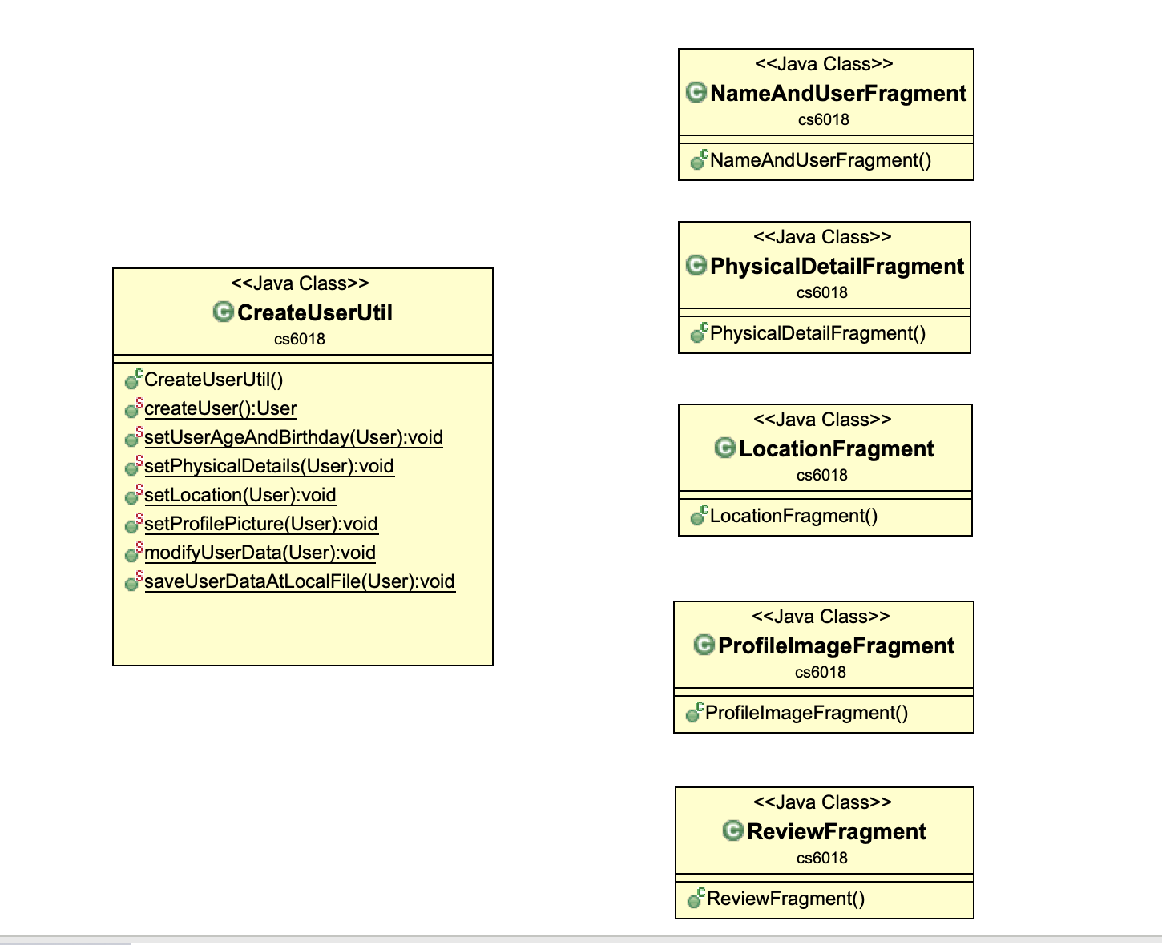
Current Class Diagram

Slide 17
UserActivity Class
User u;
public UserActivity(User u) {}
//Profile Fragment, Goal Fragment, Bmi Fragment,
public void updateUser(User u) {}
//Weather fragment
public void getWeather() {}
//Hiking
public void getHike()
//HelpFragment
public void getHelp() {}
private boolean updateLocalFileData(User u) {}

Slide 18
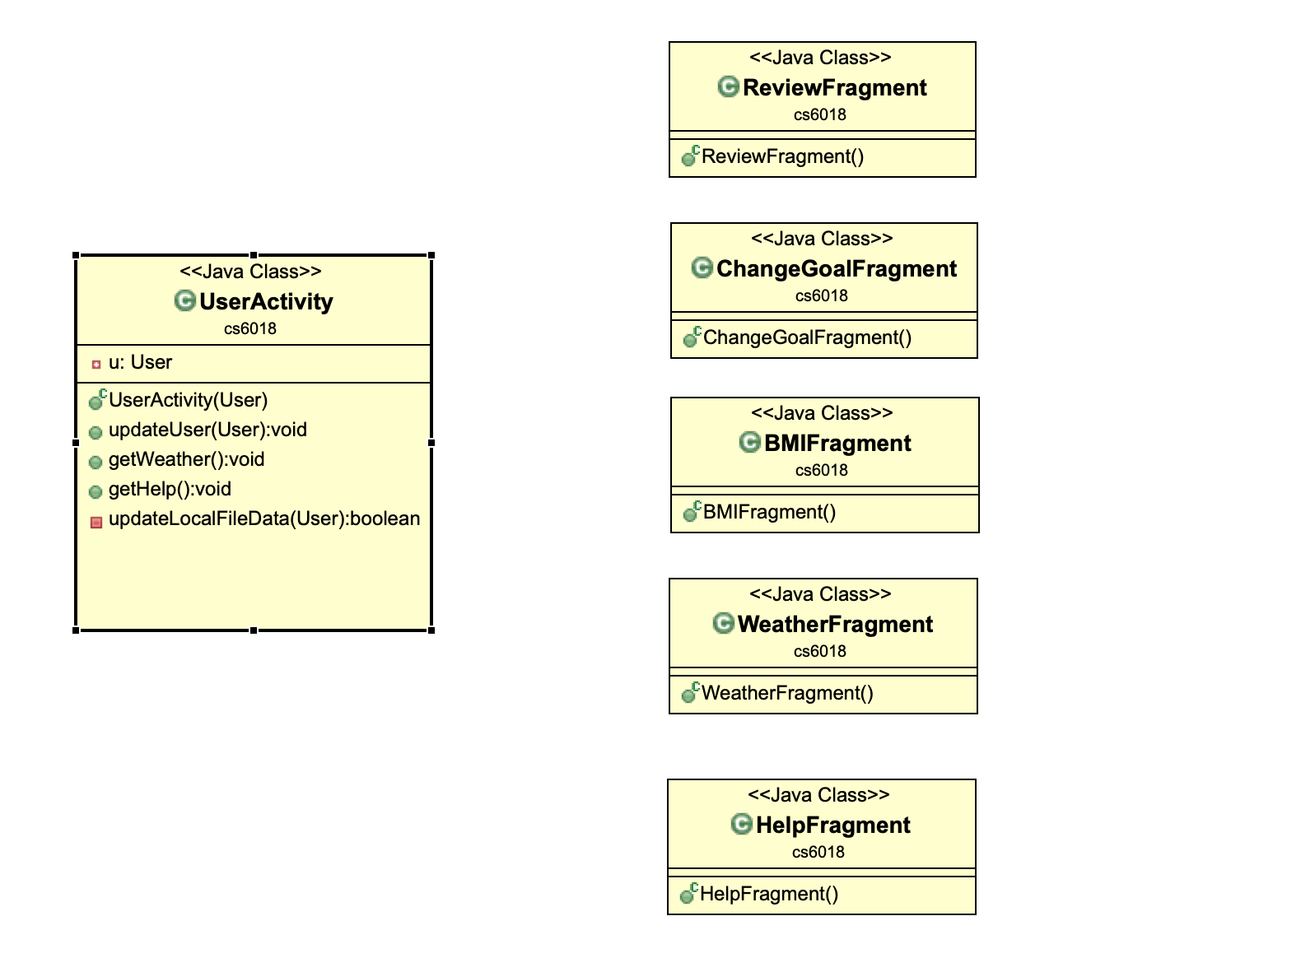
Current Class Diagram

Slide 19
Dashboard Class
UserActivity userActivity;
public Dashboard() {
User u = getUserFromLocalFile();
if (u == null) {
u = CreateUserUtil.createUser();
}
activity = new UserActivity(u);
}
private User getUserFromLocalFile() {}
public void operateOnProfile()
public void operateOnGoal()
public void getHike()
public void getWeather()

Slide 20
Class Diagram Update

Slide 21
Extensibility
OOD?
Multiple User logged In?
Database?

Slide 22
User Class
Profile profile;
Goal goal;
BMI bmi;
public User() {}
public Profile getProfile() {}
public BMI getBMI() {}

Slide 23
Profile Class
int age;
int height;
int weight;
String name;
String city;
String state;
String sex;
String image_path;
//set and get methods

Slide 24
Goal Class
String goalType;
int amount;
int avtivity_level;
//set and get methods

Slide 25
BMI Class
int amount;
String category;
public void setBMI(Profile p){}
//set and get methods

Slide 26
UserActivity Class
User u
public void updateProfile(Profile p) {}
Public void updateBMI(BMI bmi){}
Public void updateGoal(Goal goal){}

Slide 27
Dashboard Class
UserActivity userActivity;
List<User> users;
public Dashboard() {
users = getUserFromLocalFile();
if (u == null) {
u = CreateUserUtil.createUser();
users.add(u);
}
activity = new UserActivity(users.get(0));
}
public void addUser();
public void chooseUser();
private User getUserFromLocalFile() {}
public void operateOnProfile()
public void operateOnGoal()
public void getHike()
public void getWeather()

Slide 28
Test Lead
Hui Zhou

Slide 30
Questions?

